Slide 1
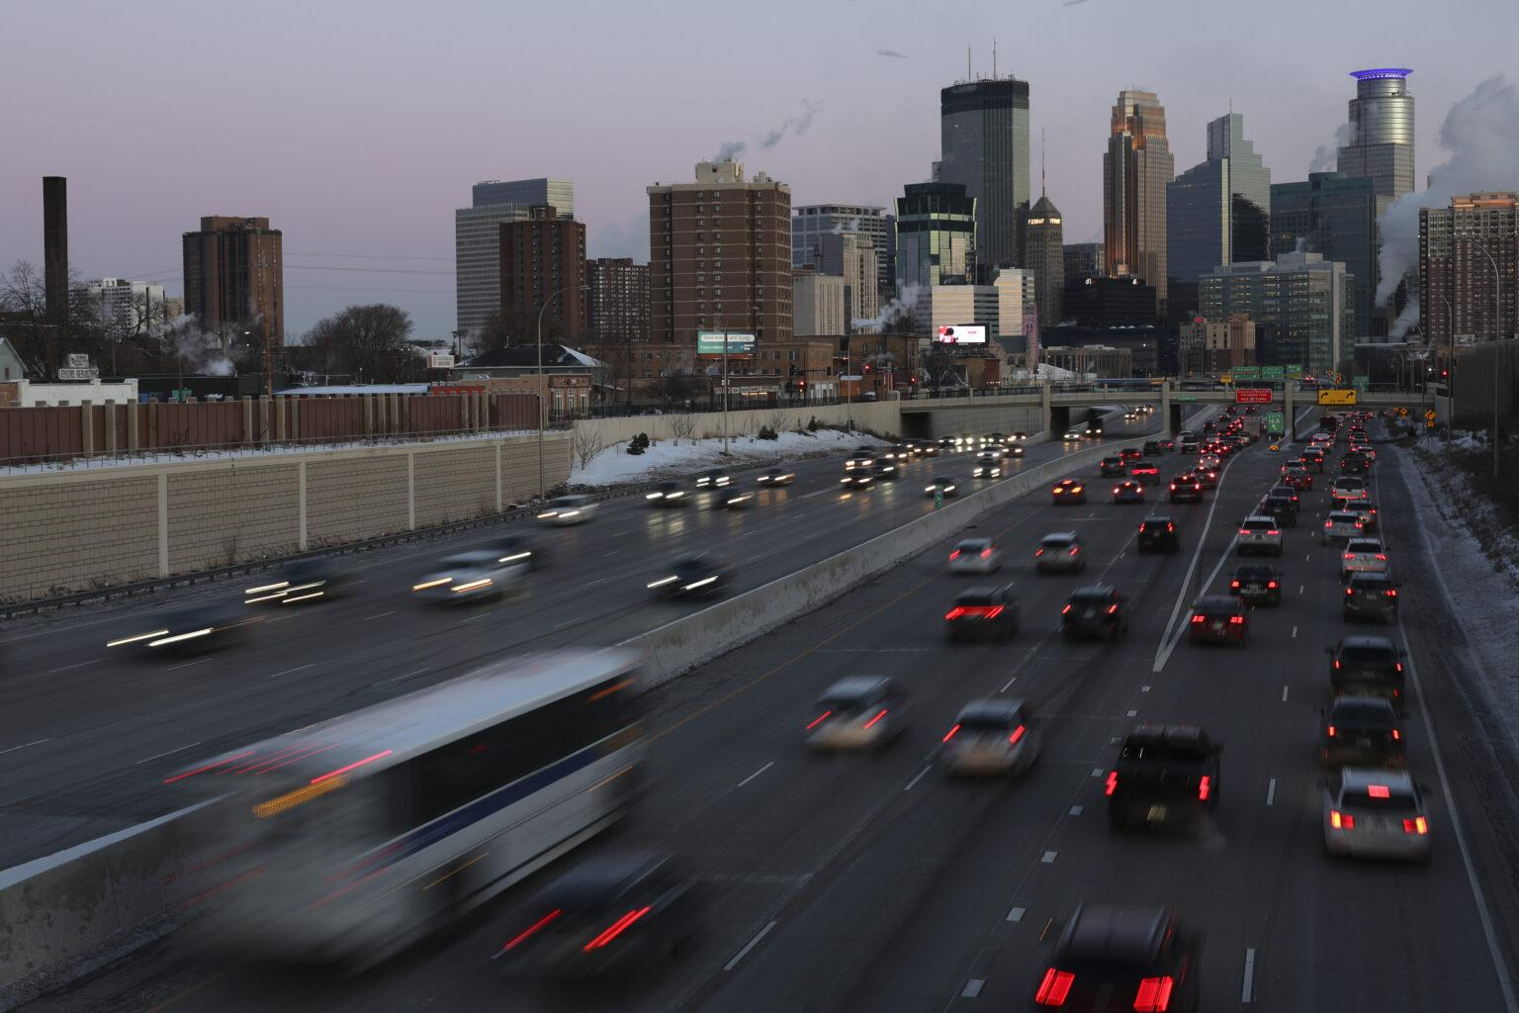

virginia levy abulafia
Version 1.0
Understanding
Minnesota’s Traffic Patterns:
Time, Weather, and Holidays (2017–2018)

Slide 2
SUMMARY
A Tableau visualization project
for the Minnesota Department of Transportation
Overview
Business Problem
Goal
Methodology
Key Insights
Recommendations

Slide 3
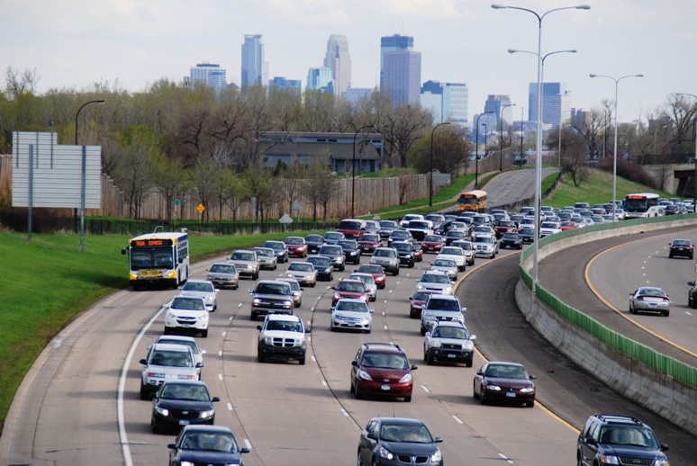
Overview
• Tableau dashboard analyzing traffic by time, weather, and holidays
• Based on Metro Interstate Traffic Volume dataset

Slide 4
Business Problem
1
Understand how traffic volume varies by season, weather, and holidays
2
Support planning to minimize disruptions during road work.

Slide 5
Project Goal
Create an interactive dashboard showing traffic by:
Year, month, weekday, and hour
Weather conditions
Holiday type

Slide 6
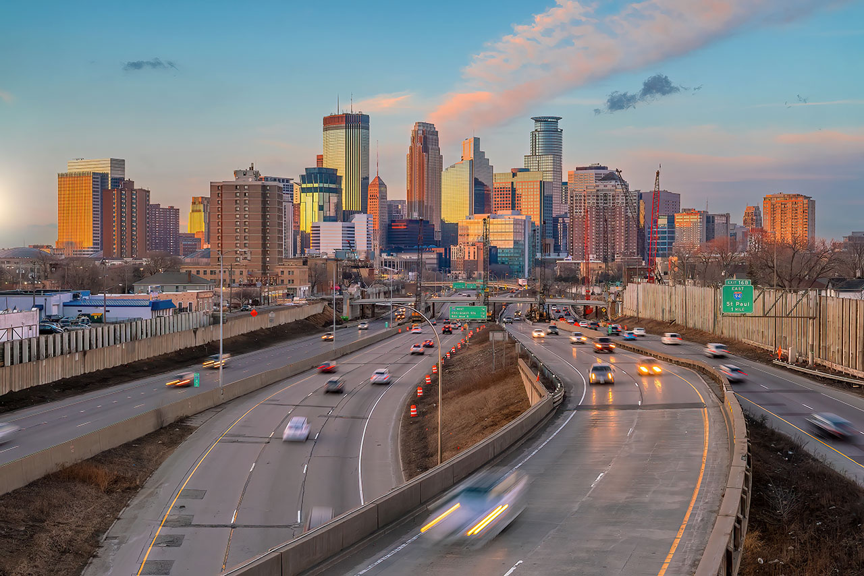
Methodology

Slide 7
Data cleaning and calculated fields in Tableau
Five key charts:
Monthly trend (2017 vs 2018)
Hourly heatmap by weekday
Volume by Weather
4, Volume by Holiday
5, Traffic Before and After Holidays

Slide 8
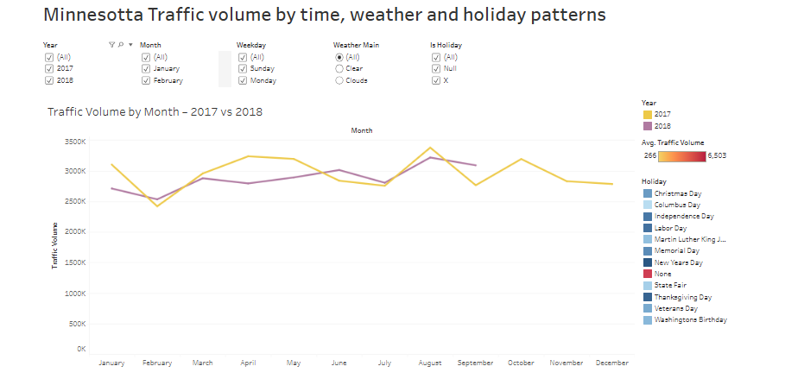

Slide 9
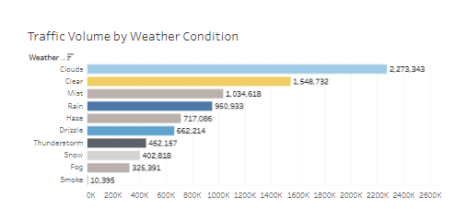
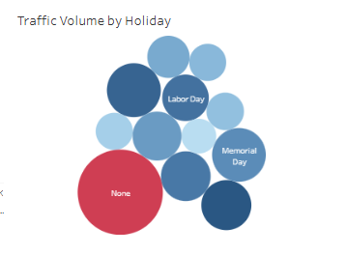
Key Insights
Higher traffic in summer months and weekday rush hours
Snow and fog reduce traffic volume
Thanksgiving and Christmas Day show highest holidays peaks

Slide 10
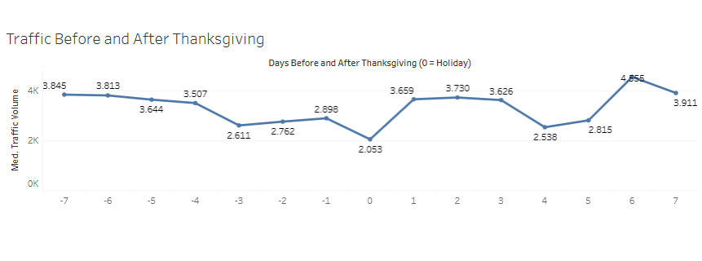
Traffic Before and After Holidays
Traffic rises before Thanksgiving (−2/−1), dips on day 0, then rebounds; a secondary mid-week spike appears around +6.
Data for 2018 are unavailable due to dataset limitations.

Slide 11
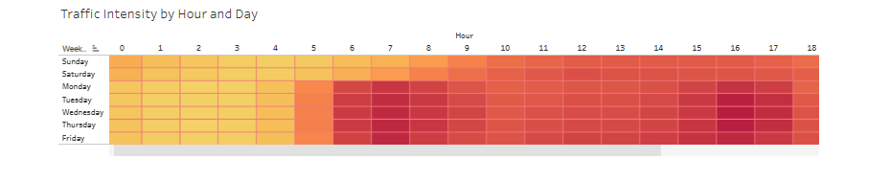
Recommendations
Schedule road work during low-traffic hours/seasons
Prepare for holiday and weather-related congestion
Use dashboard insights for planning and safety decisions
Schedule road works on the holiday itself or late-evening slots; avoid −2/−1 and +1 peaks.

Slide 12
Thank you.
virginialevy.com

